Slide 1
New HGTV Show
Presentation and Analysis/Analytics by Lauren Coats

Slide 2
Outline
Business Problem
Data & Methods
Results
Conclusion
Future work

Slide 3
Business Problem
One of HGTV Network's couples is moving to King Country and HGTV does not want to lose them. Instead of letting them go, HGTV will be using the King county's data set to figure out what type of show would fit with the couple's new areas. The most important indicator is cost since that will be use to determine the budget.

Slide 4
Data
Kings County Data (21K entries) set Metric of interest
Price
Bed
Bath
Renovated

Slide 5
Modeling and Methods
Linear regression model use to predict home price
Log transformations
Dummy variables used for categorical information
P-value below .05 used
R^2 of .84
Coefficients

Slide 6
Results
Feature | Cost of Feature
Waterfront | $23,400
View 3/4 and 4/4 | $12,120 - $19,390
Grade 9 to 12 | $16,780 - $40,090
Zip Code | up to $71,580
Basement | $58,023

Slide 7

Result
1 in 100 homes Renovated Since 2004

Slide 8
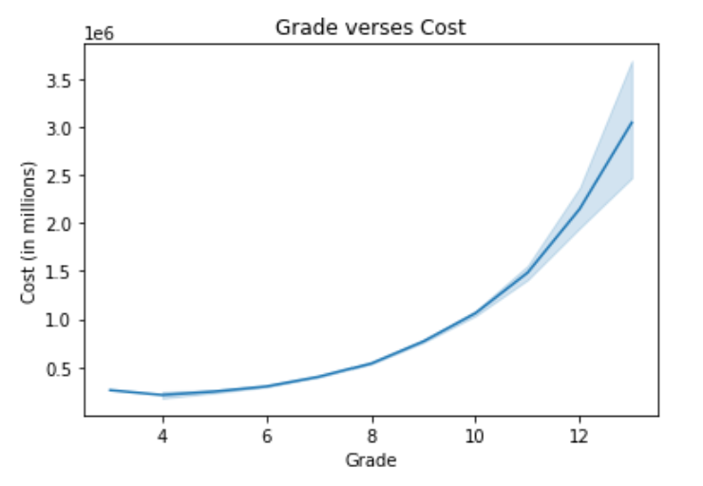

Results

Slide 9
Conclusion
Favorable Home Types
Unrenovated
< 9 grade
< 6 bedroom

Slide 10
Future Work
Figure what makes a grade 8 home vs grade 13
Compare our target home type to the target home of other shows on HGTV
Going to the location and create our own view column for certain areas
Reverse engineer the Linear regression to see what type of home we can get with in a price range

Slide 11
Thank You

